Slide 1

Consumer Goods Ad_Hoc Insights
Presented by Stephen Yan

Slide 2
Table of Contents
1
Business Background
2
Database Schema
3
Ad_Hoc Requests

Slide 3
1
Business Background

Slide 4
Atliq Hardwares is one of the leading computer hardware producers in India and many other foreign countries. However, the management needs more insights to make quick and smart data-driven decisions, so now we have 10 ad_hoc requests from which the team need an analyst to provide insights.

Slide 5
2
Database Schema

Slide 6
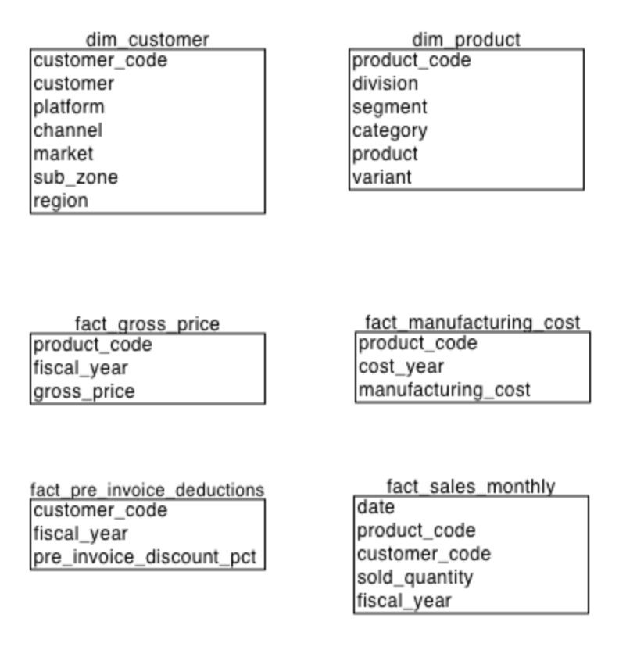
1. dim_customer: contains customer-related data
2. dim_product: contains product-related data
3. fact_gross_price: contains gross price information for each product
4. fact_manufacturing_cost: contains the cost incurred in the production of each product
5. fact_pre_invoice_deductions: contains pre-invoice deductions information for each product
6. fact_sales_monthly: contains monthly sales data for each product.

Slide 7
3
Ad_Hoc Requests

Slide 8
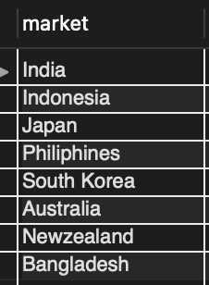
Request 1
QUESTION
OUTPUT
Provide the list of markets in which customer "Atliq Exclusive" operates its business in the APAC region.

Slide 9
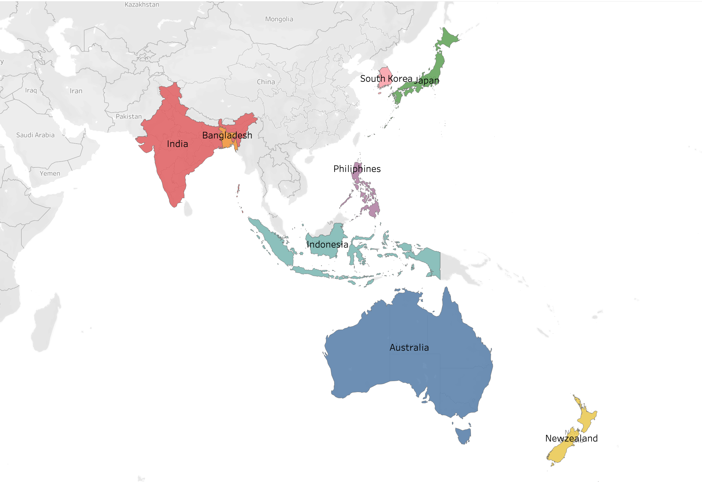
INSIGHTS:
Most of these markets in APAC regions are concentrated in Asia while only 2 are in Oceania.

Slide 10
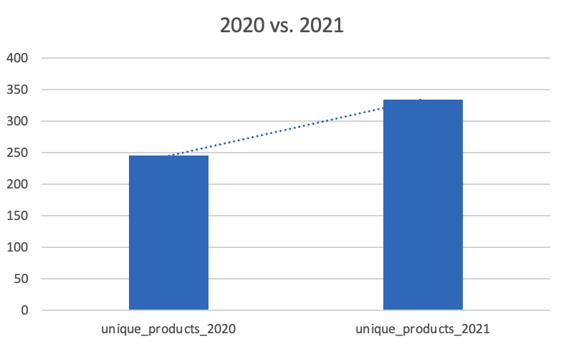
Request 2
QUESTION
OUTPUT
What is the percentage of unique product increase in 2021 vs. 2020? The final output contains these fields:
1. unique_products_2020
2. unique_products_2021
3. percentage_chg

Slide 11
Request 2 (Cont’d)
INSIGHTS
The number of products has been increased by about 36.33% from 2020 to 2021.
It shows that Atliq is investing in innovation and staying competitive by offering a wider range of products.
It is a good indication of strong growth potential for Atliq with opportunities for further expansion in the future.

Slide 12
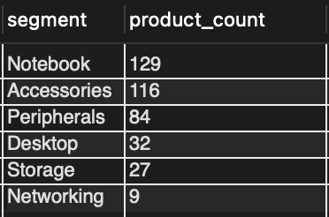
Request 3
QUESTION
OUTPUT
Provide a report with all the unique product counts for each segment and sort them in descending order of product counts. The final output contains 2 fields:
1. segment
2. product_count

Slide 13
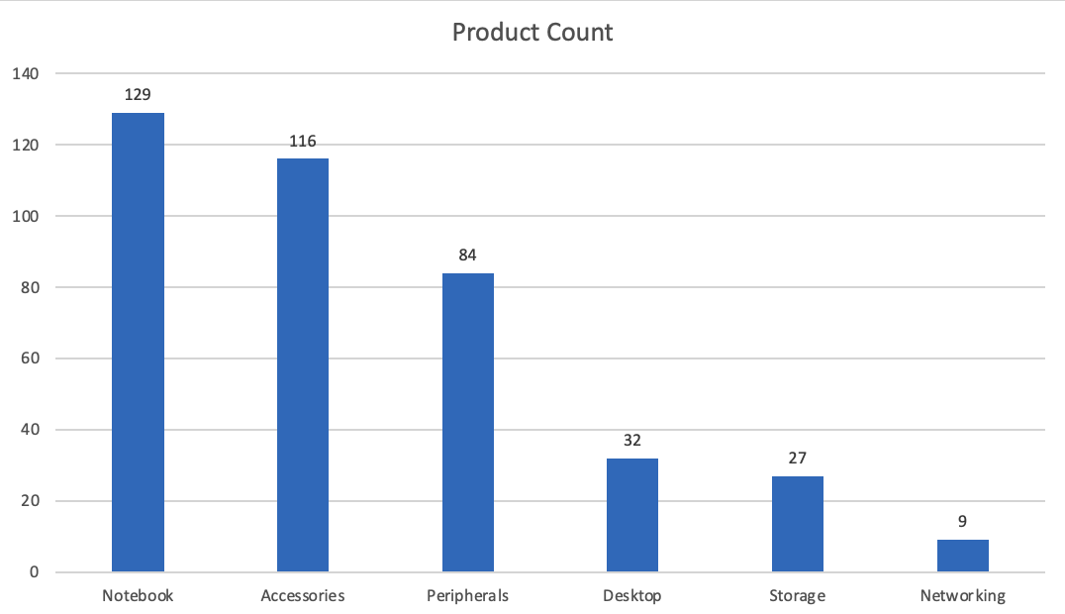
INSIGHTS:
The number of products in the Notebook, Accessories, and Peripherals segments are relatively higher than that of other segments.
It indicates a high demand in the Desktop, Storage, and Networking segments.

Slide 14
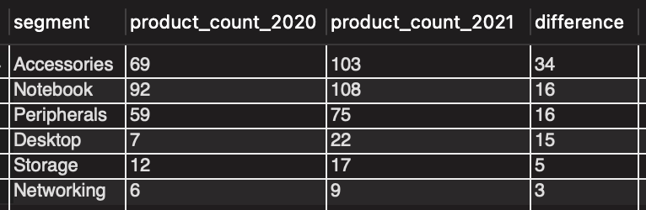
Request 4
QUESTION
OUTPUT
Follow-up: Which segment had the most increase in unique products in 2021 vs 2020? The final output contains these fields:
segment product_count_2020
product_count_2021
difference

Slide 15
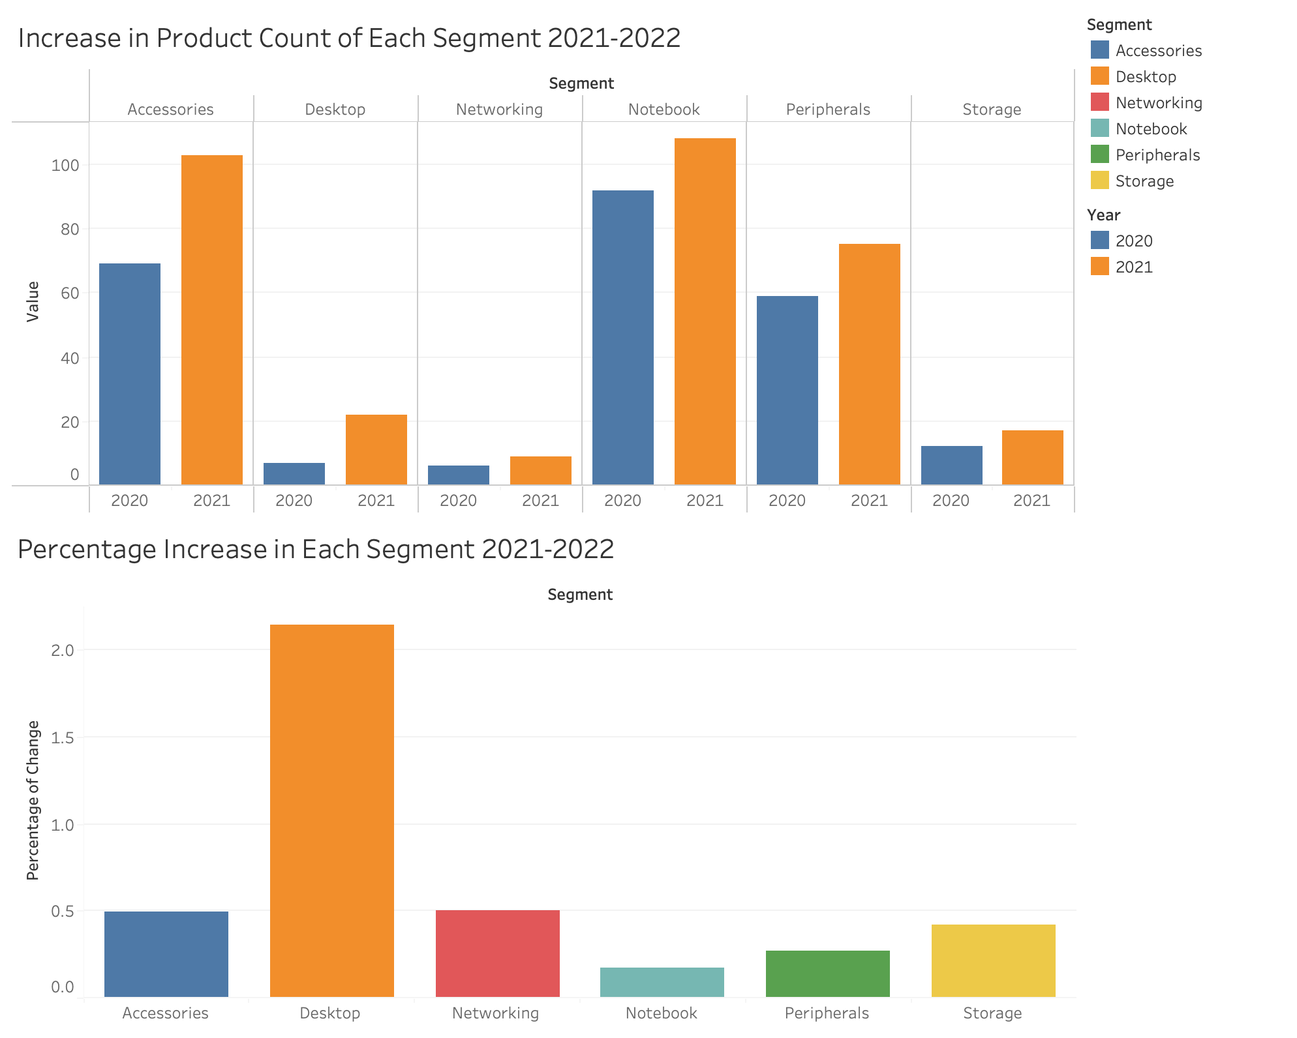
INSIGHTS
We have significantly focused on expanding product offerings within the Accessories segment in 2021, with an increase of 34 unique products. The Notebook and Peripherals segments also had noticeable increases of 16 products each.
The Desktop segment showed the largest percentage increase, growing over 200% from 7 to 22 unique products, which can be further expanded for an untapped opportunity for growth.

Slide 16
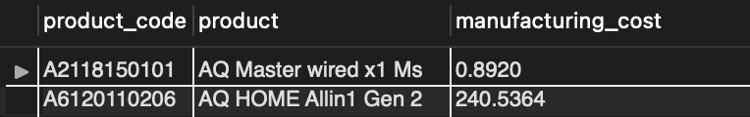
Request 5
QUESTION
OUTPUT
Get the products that have the highest and lowest manufacturing costs. The final output should contain these fields:
product_code
product
manufacturing_cost

Slide 17
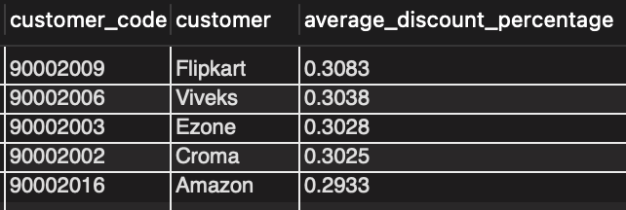
Request 6
QUESTION
OUTPUT
Generate a report which contains the top 5 customers who received an average high pre_invoice_discount_pct for the fiscal year 2021 in the Indian market. The final output contains these fields,
customer_code
customer
average_discount_percentage

Slide 18
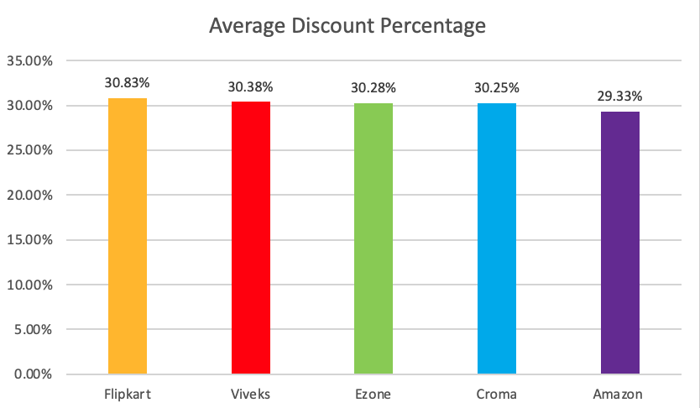
INSIGHTS:
In FY 2021, the top 5 customers in the Indian market had a similar average discount percentage overall. Flipkart had the highest average pre-invoice discount of 30.83%, while Amazon had the lowest of that with a rate of 29.33%.

Slide 19
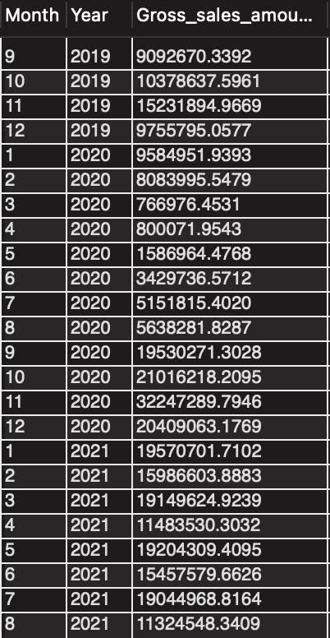
Request 7
QUESTION
OUTPUT
Get the complete report of the Gross sales amount for the customer “Atliq Exclusive” for each month. This analysis helps to get an idea of low and high-performing months and take strategic decisions.
The final report contains these columns:
Month
Year
Gross sales
Amount

Slide 20
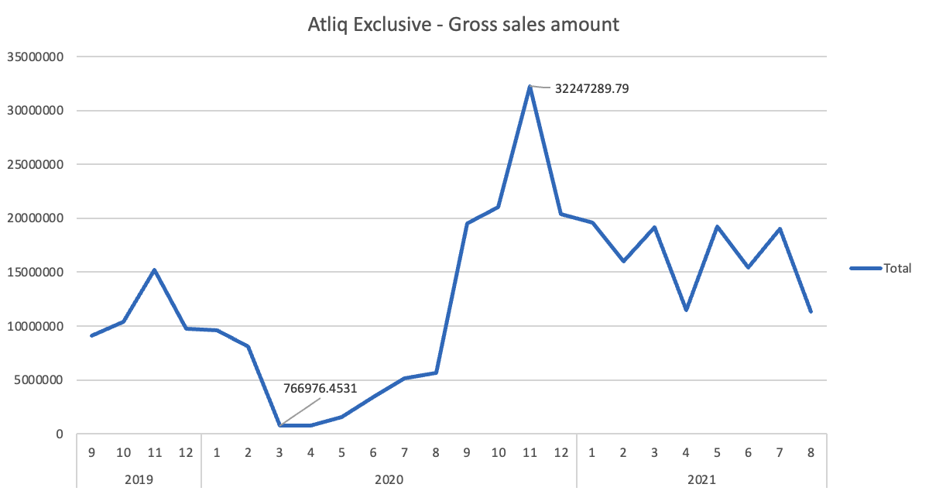
INSIGHTS:
This line chart shows the gross sales amounts for the customer “Atliq Exclusive” over a period of two years. There is a noticeable seasonal trend with a drop in gross sales amounts in the early to mid 2020, which was followed by a significant increase in the latter part of the year, and the highest gross sales amount about $32M occurs in November 2020.

Slide 21
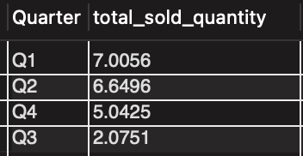
Request 8
QUESTION
OUTPUT
In which quarter of 2020, got the maximum total_sold_quantity? The final output contains these fields sorted by:
1. Quarter
2. total_sold_quantity

Slide 22
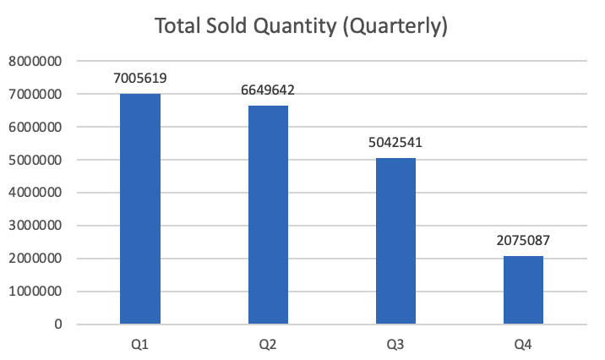
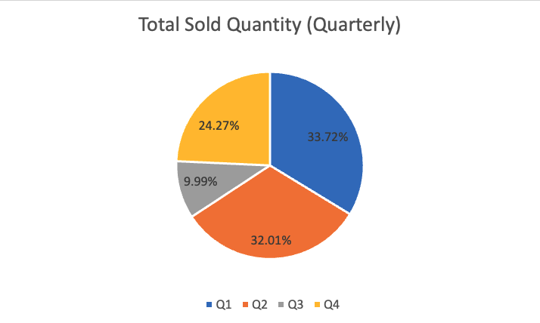
In the first quarter of FY 2020, Atliq had the most total quarterly sold quantity with about 7 million units.
Atliq's sales volume in the first half of FY 2020 accounted for a large proportion of the annual sales volume.

Slide 23
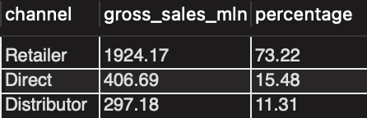
Request 9
QUESTION
OUTPUT
Which channel helped to bring more gross sales in the fiscal year 2021 and the percentage of contribution? The final output contains these fields:
channel
gross_sales_mln
percentage

Slide 24
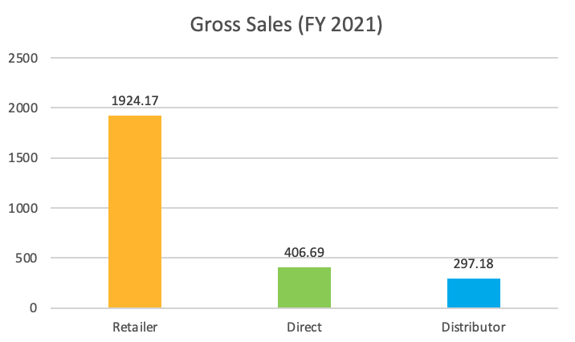
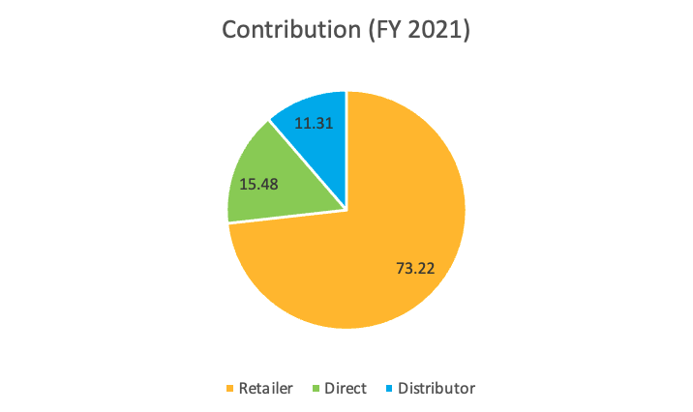
INSIGHTS:
In FY 2021, retailers brought the highest gross sales among these channels with about $1924.17M, which contributed to 73% of total gross sales, whereas only 26% of that came from direct sales and the Distributor channel.

Slide 25
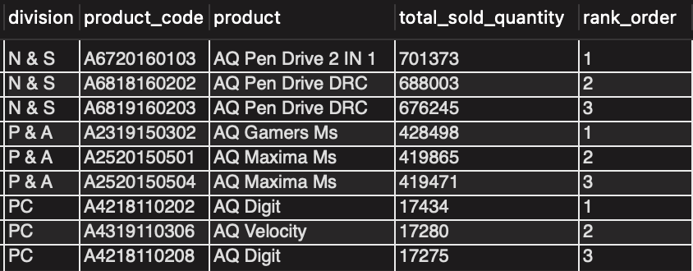
Request 10
QUESTION
OUTPUT
Get the Top 3 products in each division that have a high total_sold_quantity in the fiscal_year 2021? The final output contains these fields:
division
product_code
product
total_sold_quantity
rank_order

Slide 26
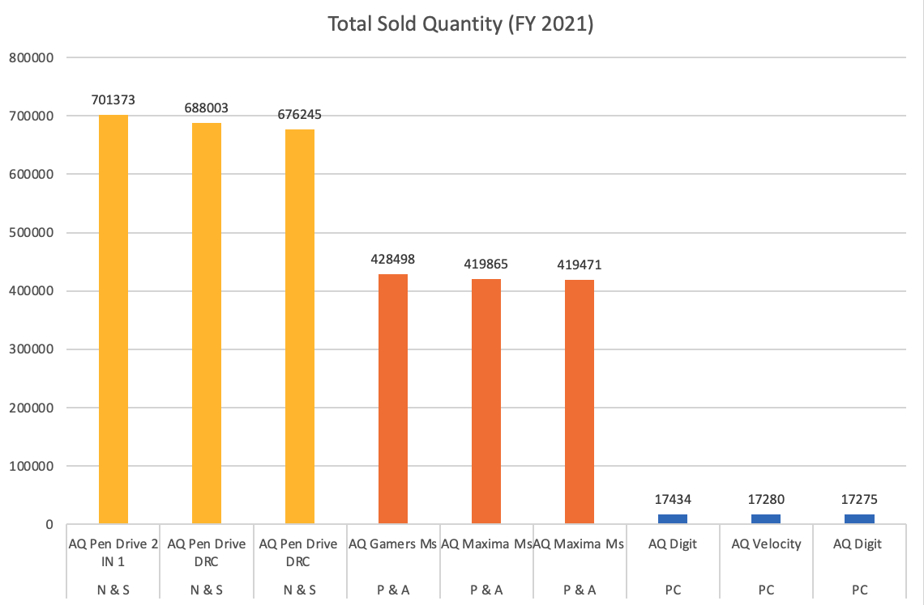
INSIGHTS:
“AQ Pen Drive 2 IN 1” is the bestselling products in FY2021, which falls into the No.1 division ”N & S”, whereas “AQ Digit” in the “PC” division is the least popular product.
There are huge differences between the total number of sold quantity of each division.
Overall, the products in each division had similar sales volume.

Slide 27
Thanks!
www.linkedin.com/in/stephenyan0603/

